Slide 1
EE232: Lightwave Devices
Prof: Ming Wu
GSI: Kevin Han
Discussion 1/17/18

Slide 2
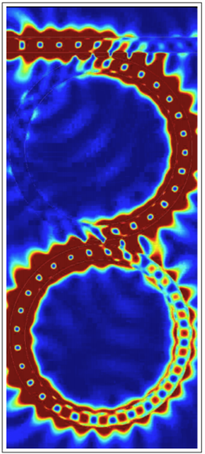
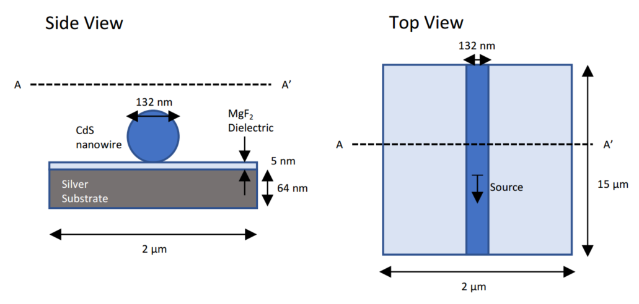
EE232 overview
Lectures will mainly cover lasers and detectors
Discussions will mainly cover other photonic devices – waveguides, couplers, modulators
Lumerical FDTD and related applications will be used throughout discussion and for final project
Dual microring resonator
CdS nanowire laser
Notes:
Unusual plasmonic laser structure

Slide 3
Today: intro to FDTD
General FDTD simulation and E&M concepts
Example: DVD reader

Slide 4
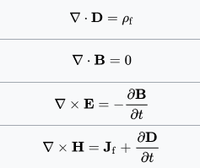
General simulation concepts
The finite-difference time domain (FDTD) method simulates Maxwell’s equations in the time domain:
Constitutive relations:
Pros: easy to implement, covers wide frequency range in single simulation, can handle most material types
Cons: meshing can be tricky, large simulations difficult
Can extract far field using post-processing

Slide 5
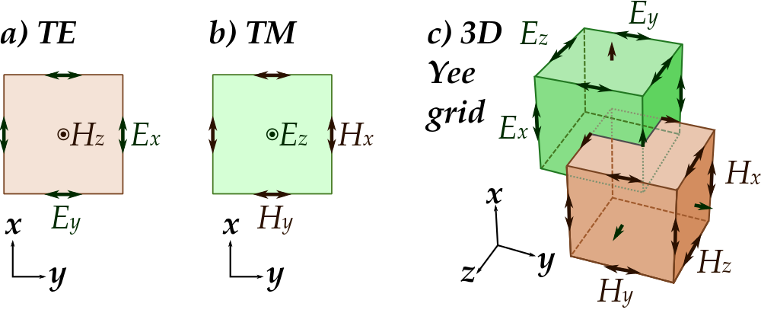
General simulation concepts
FDTD evaluates Maxwell’s equations on a grid, eg.
(Faraday’s law)
…
Source: Wikipedia

Slide 6
General simulation concepts
Radiation
Object
Source

Slide 7
General simulation concepts
Computational domain
Radiation
Object
Source
Truncation boundary

Slide 8
Boundary conditions
Perfectly matched layer (PML)
Computational domain
Radiation
Object
Source

Slide 9
Perfectly matched layer (PML)
Artificial material that absorbs radiation without reflection
This is perhaps the most common way to truncate a computational domain.
Disadvantages:
Some reflections from PML can occur. This can be minimized by ensuring that radiation hits PML at a 90 degree angle; i.e. place PML far from any scatterer or use circular computation domain if possible
Magnitude of reflections is wavelength dependent
Additional computational complexity: PML needs to be meshed and the fields need to be solved in this region

Slide 10
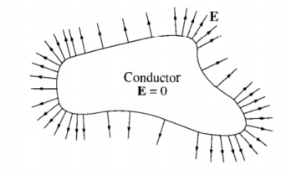
Other boundary conditions
Perfect electrical conductor (PEC): All radiation is reflected
Perfect magnetic conductor (PMC): Less common
Periodic boundary condition: Used for periodic structures. Need only simulate a unit cell.
Source: Griffiths, Intro to Electrodynamics

Slide 11
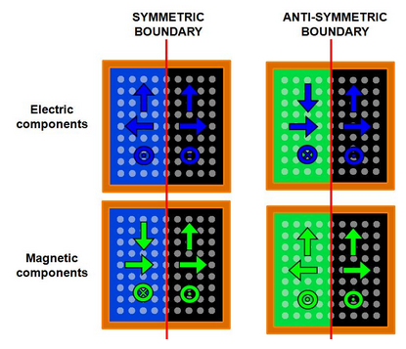
Other boundary conditions
Symmetric and anti-symmetric boundary: used when simulation has a mirror symmetry, to reduce simulation time by factor of 2, 4, or 8

Slide 12
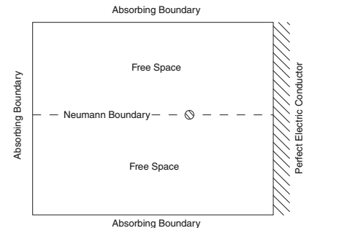
Example
Line current source
Source: Jianming Jin, “Theory and Computation of Electromagnetic Fields”

Slide 13
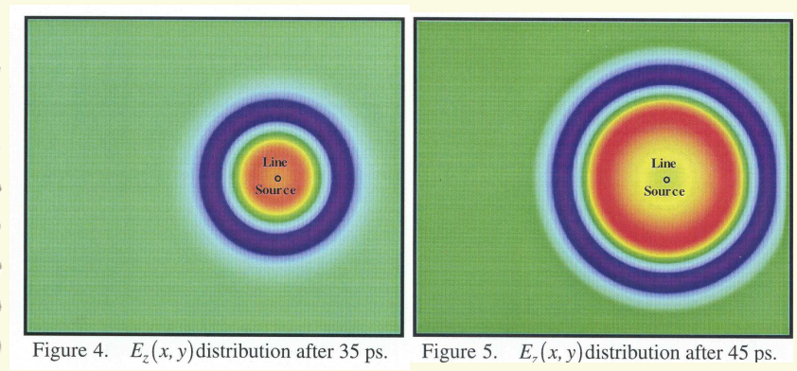
Source: Jianming Jin, “Theory and Computation of Electromagnetic Fields”

Slide 14
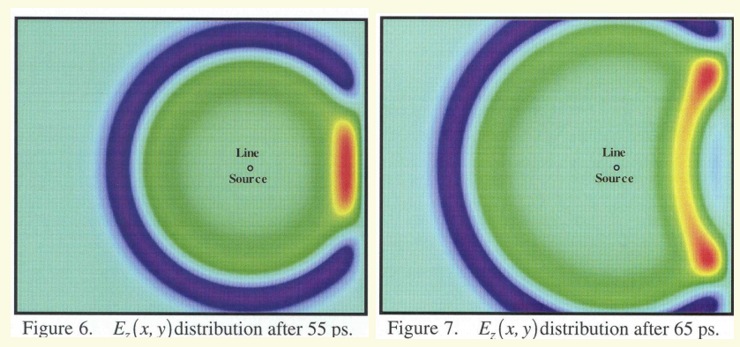
Source: Jianming Jin, “Theory and Computation of Electromagnetic Fields”

Slide 15
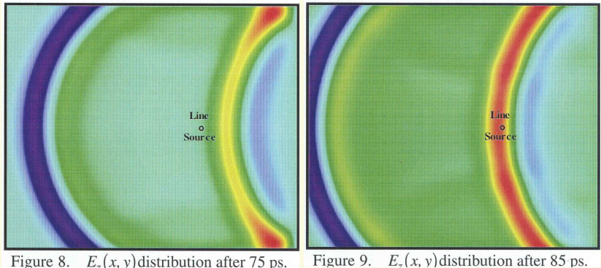
Source: Jianming Jin, “Theory and Computation of Electromagnetic Fields”

Slide 16
FDTD code implementation for previous example
for n=1:1:timesteps
Jz(src_X,src_Y)=exp(-0.5*(((n-1)*delt)/(2*period))^2)*sin(omega*(n-1)*delt);
%Size of grids
%Bx,Hx M rows, N-1 columns
%By,Hy M-1 rows, N columns
%Dz,Ez M rows, N columns
%Magnetic flux (Bx, By)
Bx(1:M,1:N-1)=(1./beta_y(1:M,1:N-1)).*(alpha_y(1:M,1:N-1).*Bx_negt(1:M,1:N-1)-...
(epsilon/dely)*(Ez_negt(1:M,2:N)-Ez_negt(1:M,1:N-1)));
By(1:M-1,1:N)=(1./beta_z(1:M-1,1:N)).*(alpha_z(1:M-1,1:N).*By_negt(1:M-1,1:N)+...
(epsilon/delx)*(Ez_negt(2:M,1:N)-Ez_negt(1:M-1,1:N)));
%Magnetic field intensity (Hx, Hy)
Hx(1:M,1:N-1)=(1./beta_z(1:M,1:N-1)).*(alpha_z(1:M,1:N-1).*Hx_negt(1:M,1:N-1)+...
(1/mu)*beta_x(1:M,1:N-1).*Bx(1:M,1:N-1)-...
(1/mu)*alpha_x(1:M,1:N-1).*Bx_negt(1:M,1:N-1));
Hy(1:M-1,1:N)=(1./beta_x(1:M-1,1:N)).*(alpha_x(1:M-1,1:N).*Hy_negt(1:M-1,1:N)+...
(1/mu)*beta_y(1:M-1,1:N).*By(1:M-1,1:N)-...
(1/mu)*alpha_y(1:M-1,1:N).*By_negt(1:M-1,1:N));
%Electric flux (Dz)
Dz(2:M-1,2:N-1)=...
(1./beta_x(2:M-1,2:N-1)).*(alpha_x(2:M-1,2:N-1).*Dz_negt(2:M-1,2:N-1)...
+(epsilon/delx)*(Hy(2:M-1,2:N-1)-Hy(1:M-2,2:N-1))...
-(epsilon/dely)*(Hx(2:M-1,2:N-1)-Hx(2:M-1,1:N-2))-epsilon*Jz(2:M-1,2:N-1));
%Electric field intensity (Ez)
Ez(2:M-1,2:N-1)=...
(1./beta_y(2:M-1,2:N-1)).*(alpha_y(2:M-1,2:N-1).*Ez_negt(2:M-1,2:N-1)...
+(1/epsilon)*beta_z(2:M-1,2:N-1).*Dz(2:M-1,2:N-1)...
-(1/epsilon)*alpha_z(2:M-1,2:N-1).*Dz_negt(2:M-1,2:N-1));
%Apply Etan=0 B.C
Ez(1:M,25)=0;
%Update field components
Ez_negt=Ez;
Hx_negt=Hx;
Hy_negt=Hy;
Dz_negt=Dz;
Bx_negt=Bx;
By_negt=By;
< 50 lines of MATLAB code!

Slide 17
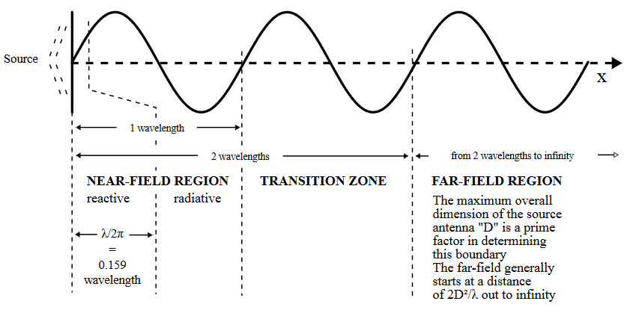
Propagating to far-field
FDTD can generally only simulate near-field effects due to need to mesh entire region
Often we are interested in the fields far away from simulation ($r≫λ$)
Source: Wikipedia

Slide 18
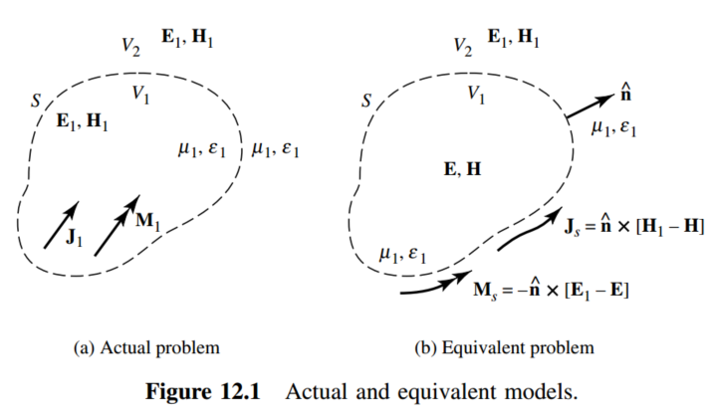
Propagating to far-field
Can calculate far-field using equivalence principle:
Pick a closed surface enclosing sources
Run simulation and record fields on surface
Replace fields on surface with equivalent current sources
Use radiation equations to determine E₁, H₁ fields in far-field
Vector potential A
Current source J
Can pick to be zero
Source: Balanis, Antenna Theory

Slide 19
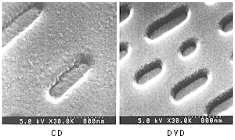
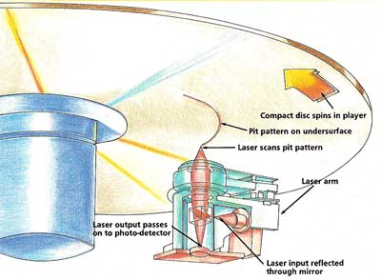
How a DVD works
Basic idea: Laser is scanned over DVD. If laser beam encounters pit the light
will be scattered away and will not reach the photodetector (Binary 1). Otherwise,
most laser light is reflected back toward the photodetector (Binary 0).
Source: http://functionalcd.weebly.com/

Slide 20
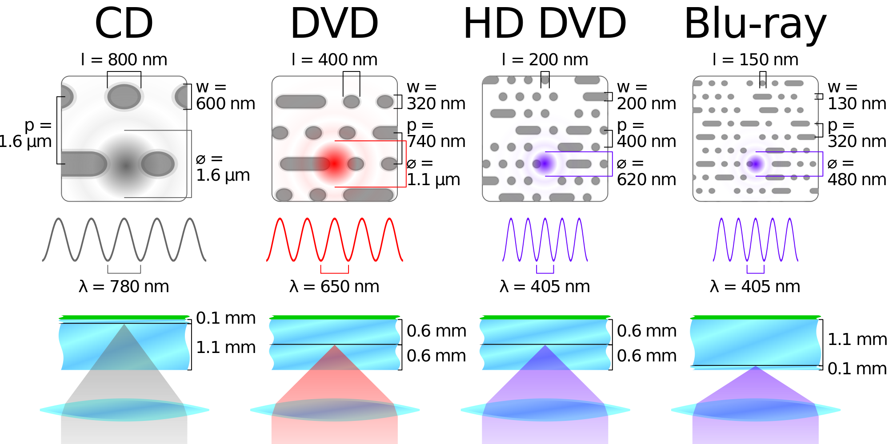
How a DVD works
Source: Wikipedia

Slide 21
FDTD simulation
Polycarbonate (n=1.55)
Using Lumerical FDTD, we would like to optimize the dimension of the “pit” such that we maximize the amount
of laser light scattered.
PML
We will assume focused Gaussian spot for 650nm laser.
PML / PEC boundary conditions will be utilized to truncate the computational domain.
We will use FDTD to calculate the far-field light radiation
scattered by the pit.
Laser
650nm
PML
PML
320nm
120nm
pit
land
PEC
Aluminum

Slide 22
Next time
Install Lumerical FDTD Solutions
Walk-through creating and running simulation of DVD pit
Analyze results
Investigate modifying pit height

Slide 23
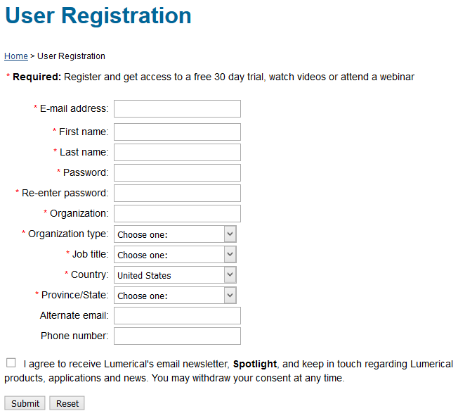
Installing FDTD Solutions
https://www.lumerical.com/register.html
Use @berkeley.edu address

Slide 24
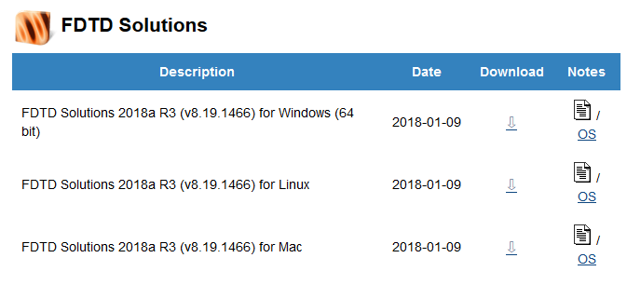
Installing FDTD Solutions
Log in here:
You will get an email with the license code
Download FDTD Solutions
Extract zip file
Run the installer
Start the program
https://www.lumerical.com/portal/workshop.html?ec=CDF54A

Slide 25
Installing FDTD Solutions
Check email for activation code
Enter it here
Click Activate

Slide 26
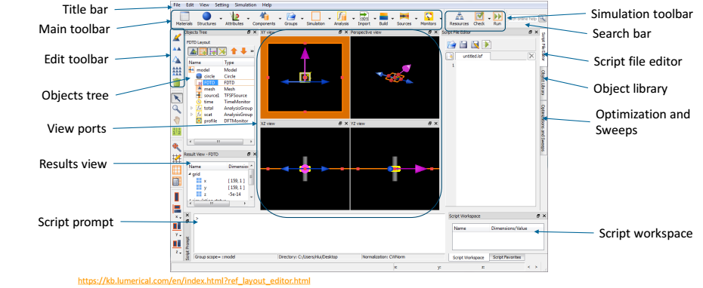
Lumerical FDTD program

Slide 27
Create ‘land’ geometry
We will create a rectangle consisting of Aluminum.
To create a rectangle and edit the properties:
Structures → Rectangle
Right click on rectangle in Objects Tree; select Edit object

Slide 28
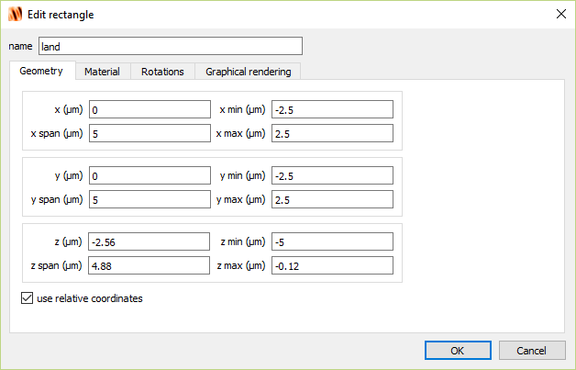
Create ‘land’ geometry

Slide 29
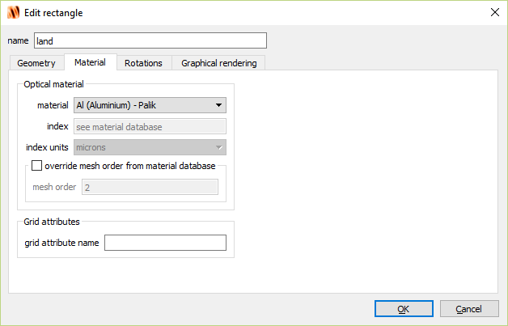
Create ‘land’ geometry

Slide 30
Create simulation window
To create a simulation window and edit the properties:
Simulation → Region
Right click on FDTD in Objects Tree; select Edit object

Slide 31
Create simulation window

Slide 32
Create simulation window

Slide 33
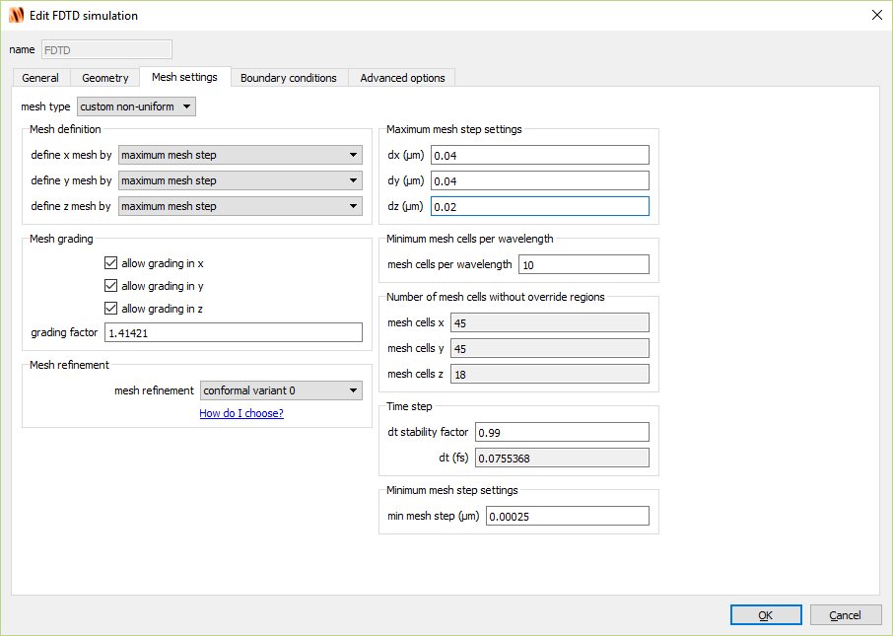
Create simulation window

Slide 34
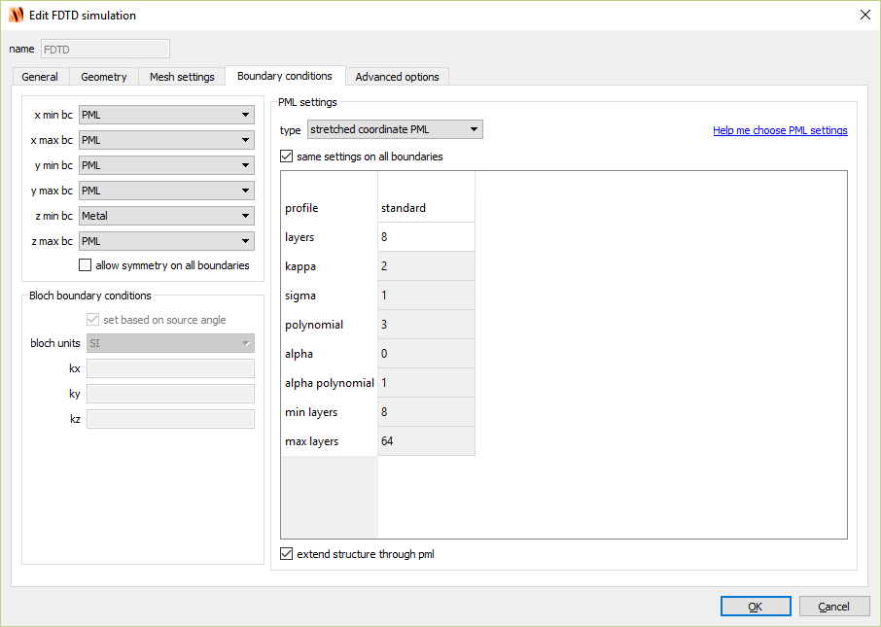
Create simulation window

Slide 35
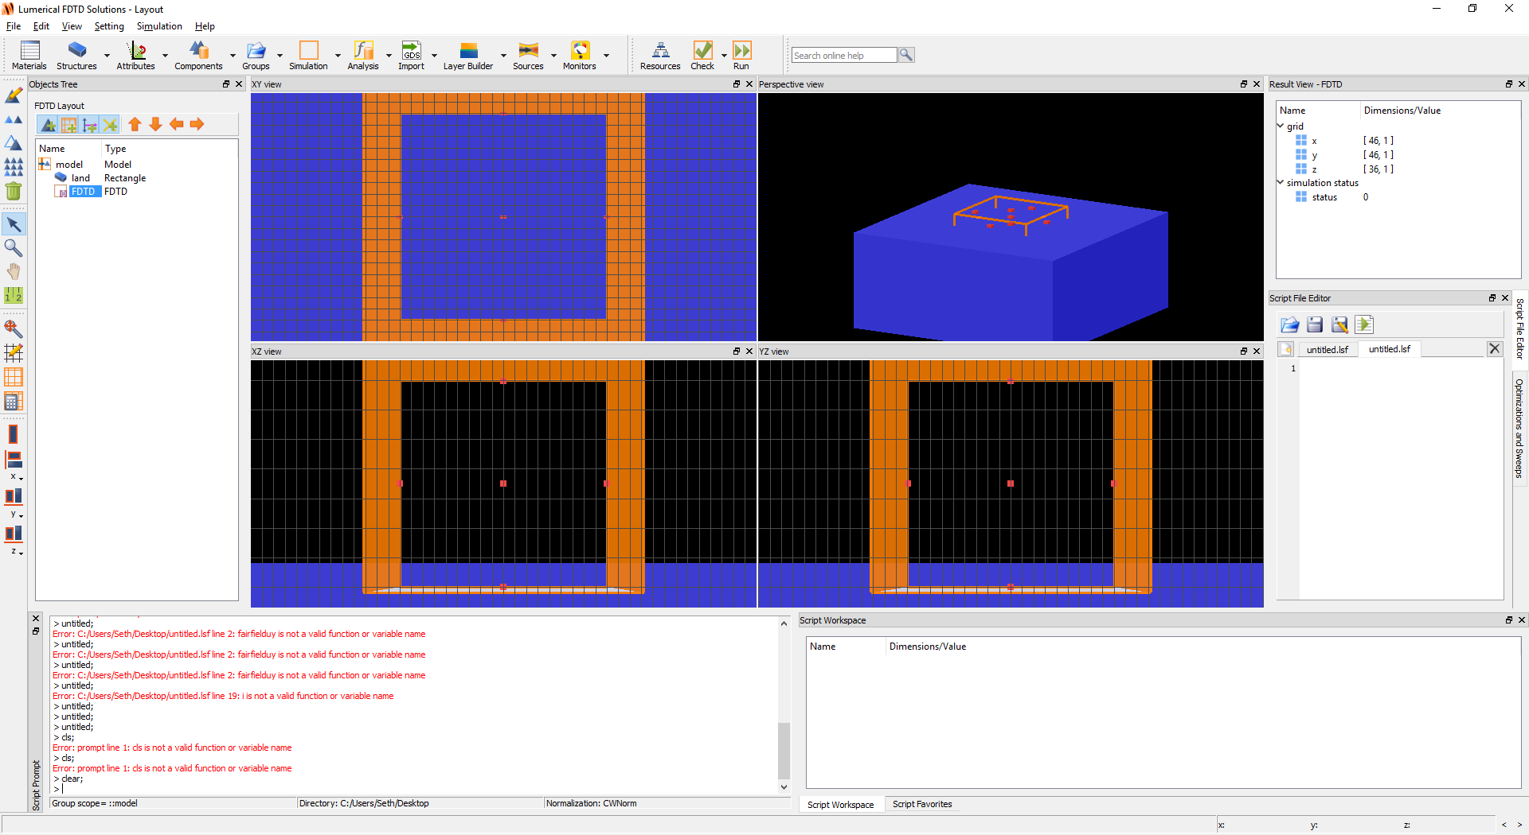
Create simulation window
Hint: Click FDTD in the Objects Tree then click Zoom extents icon on the left-hand side

Slide 36
Create source
To create a simulation window and edit the properties:
Sources → Gaussian
Right click on source in Objects Tree; select Edit object

Slide 37
Create source

Slide 38
Create source

Slide 39
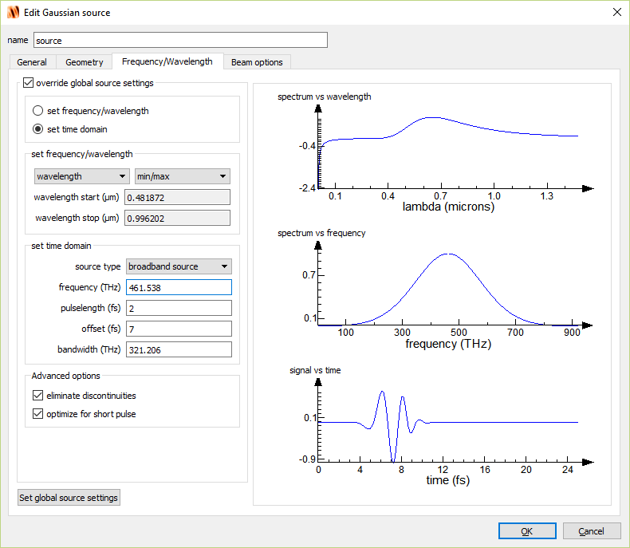
Create source

Slide 40
Create source

Slide 41
Create field monitor
To create a simulation window and edit the properties:
Monitors → Frequency-domain field and power
Right click on DFTMonitor in Objects Tree; select Edit object

Slide 42
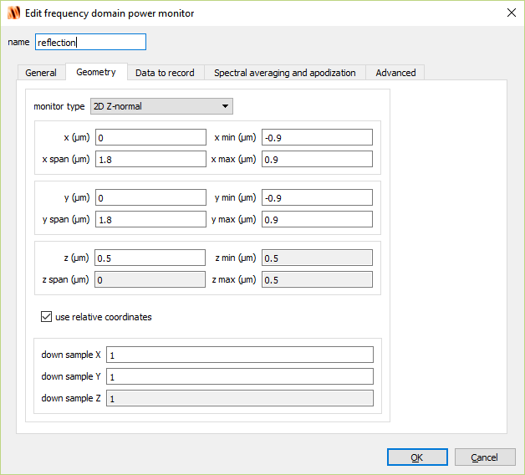
Create field monitor

Slide 43
Create time-domain monitor
To create a simulation window and edit the properties:
Monitors → Frequency-domain field and power
Right click on DFTMonitor in Objects Tree; select Edit object

Slide 44
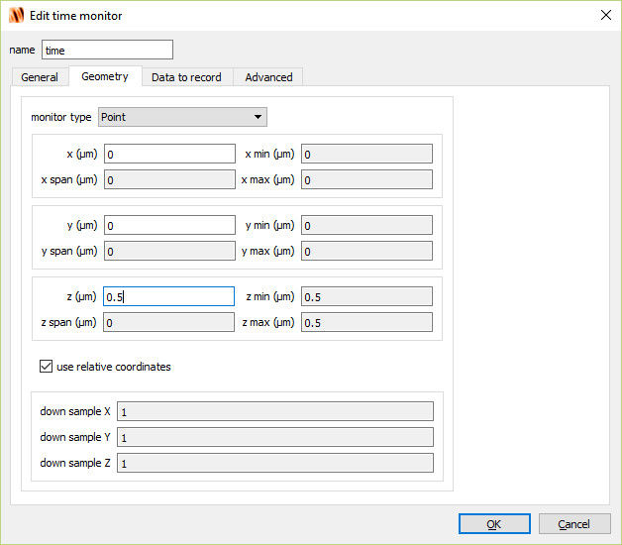
Create time-domain monitor

Slide 45
Create movie monitor
To create a simulation window and edit the properties:
Monitors → Movie
Right click on MovieMonitor in Objects Tree; select Edit object

Slide 46
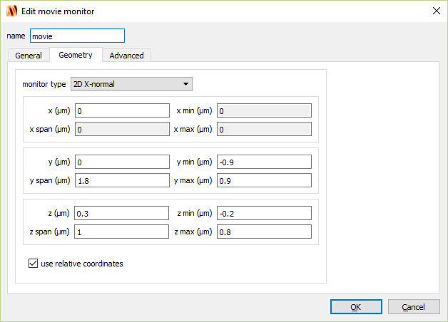
Create movie monitor

Slide 47
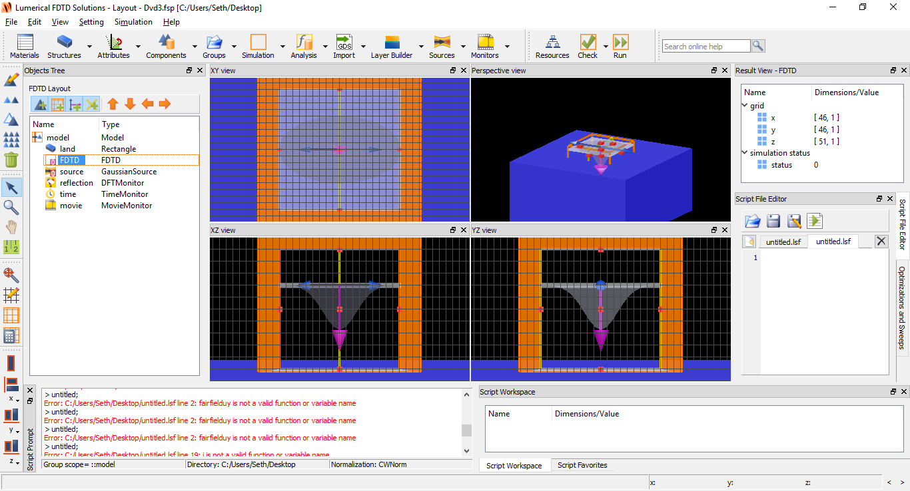
Run simulation
Click the Run icon

Slide 49
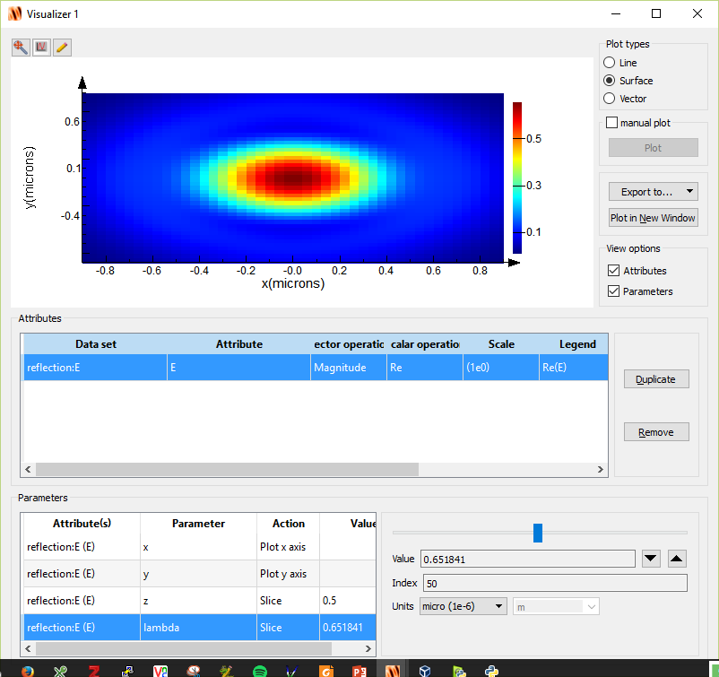
Analyze field-monitor
Right-click reflection → visualize → E
Click lambda in the Parameters window.
Drag the slider until Value ~ 0.650

Slide 50
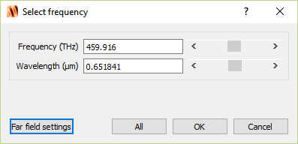
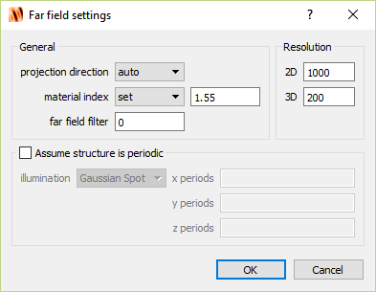
Far-field calculation
In the Result View, right-click farfield and click Calculate
Set the wavelength to 0.651841 and click Far Field settings.
Set the material index to 1.55

Slide 51
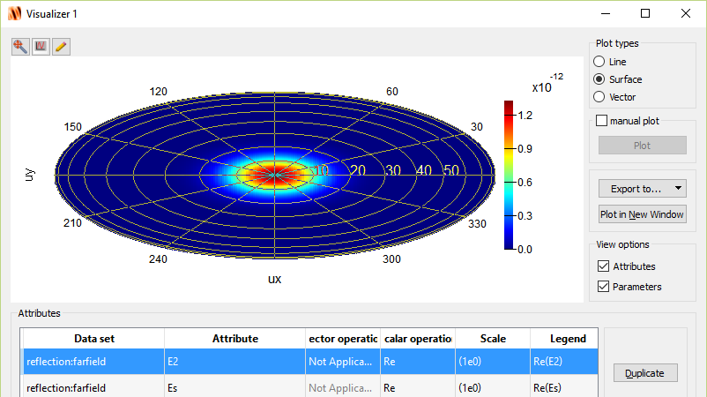
Far-field calculation
In the Result View, right-click farfield and click Visualize

Slide 52
Far-field calculation
These results are not too interesting. All we are observing is the simple reflection of a laser beam from a metallic surface.
Let’s add a DVD ‘pit’

Slide 53
Create ‘pit’ geometry
We will create a rectangle consisting of Aluminum.
To create a rectangle and edit the properties:
Structures → Rectangle
Right click on rectangle in Objects Tree; select Edit object

Slide 54
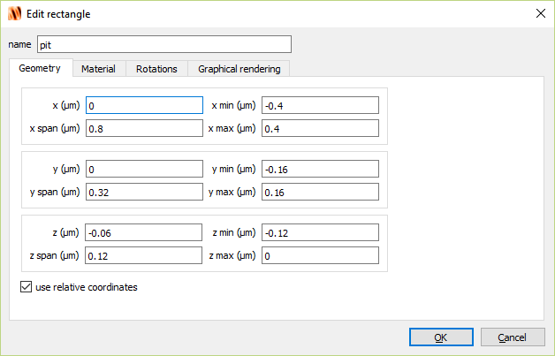
Create ‘pit’ geometry

Slide 55
Create ‘pit’ geometry

Slide 57
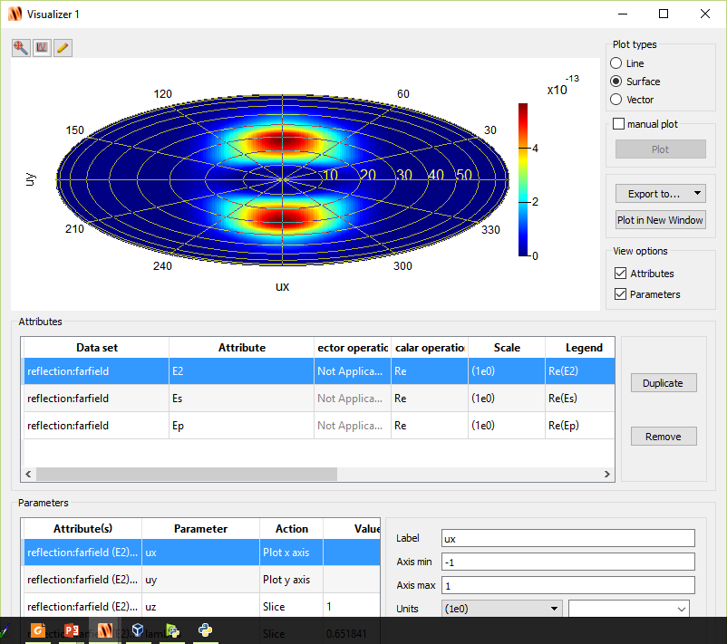
Far-field
Lobes indicate that light is scattered away at angles

Slide 58
How to maximize scattering?
Polycarbonate (n=1.55)
Let’s loosely think of the laser beam as impinging optical rays.
$$Δφ_{1}$$
$$Δφ_{2}$$
Some of the rays (red) will hit the pit and reflect back with a phase change of $Δφ_{1}=π.$
Other rays (blue) will hit the land and reflect back with a phase change of $Δφ_{2}=π+4πnd/λ$
d
pit
land
Destructive interference for$\left|Δφ_{2}−Δφ_{1}\right|=π$
What happens to the light? It’s scattered away!
We can quickly calculate that we need $d=λ/4n=120nm$ for destructive interference to occur.
Aluminum

Slide 59
How to maximize scattering?
What if $\left|Δφ_{2}−Δφ_{1}\right|=2π?$
Then we have constructive interference and we should expect that most light will be reflected straight back as if there was no ‘pit’ present.
Let’s test this out...
Then we need $d=240nm$
Polycarbonate (n=1.55)
$$Δφ_{1}$$
$$Δφ_{2}$$
d
pit
land
Aluminum

Slide 60
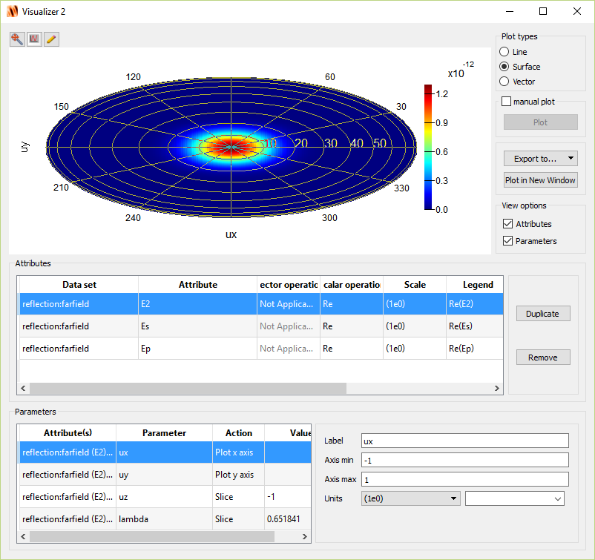
Far-field
Most light is scattered straight back as if ‘pit’ is not present!

Slide 61
Far-field comparison
240nm
pit
120nm
pit
land
land

